Slide 1
Date: 16 December 2025

Slide 2




Weekly report: Team Gearbox, Brake, Coupling
Week number : 12
Date: 16/12/2025
Supervisor: Prof. Peter Quell
Group Members :Nehang Jitendra Joshi,Santo Mazumder,Md Razaul Karim Rahat
Presented by -Md Razaul Karim Rahat
16-12-2025
Gearbox, Brake, Coupling

Slide 3
List of Content
Gearbox calculation and design
Brake calculation and design
Coupling calculation and design
Weight and Cost calculations
16-12-2025
Md Razaul Karim Rahat
Gearbox, Brake, Coupling

Slide 4
Gearbox parameter calculation
Parameter | Value
Input torque,Mi KN m | 5,095
Output torque,Mo KN m | 41,9
Input speed, rpm | 10.15
Output speed, rpm | 1200
Parameter | Value | Unit
I _{gearbox} | 120 | -
η _{gearbox} | 0.97 | %
M _{N, Generator} | 5.6169 | KNm
M _{N, Rotor} | 411.55 | KNm
16-12-2025
Md Razaul Karim Rahat
Gearbox, Brake, Coupling

Slide 5
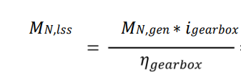
Gearbox Coupling Torque calculation
Torque transfer
These values considered the losses of the different electrical components like generator, converter, and transformer. From this torque and the efficiency (97%) and ratio (120) of the gearbox, the nominal torque at the low-speed shaft 𝑀𝑁,𝑙𝑠𝑠 can be calculated as following
41.9 *120 / 0.97 = 5,183.50 KNm
Torque overload protection
For this, a breakdown torque of the coupling of 2.5 times the nominal torque is required by industry experience. The components behind the coupling are designed to withstand a higher torque than this breakdown torque, so that the coupling will fail first and the other components are protected in cases of overloads.
Mn,lss * 2.5 = 12,958.75 KNm - Breakdown
16-12-2025
Md Razaul Karim Rahat
Gearbox, Brake, Coupling

Slide 6
Gearbox calculation
Items | Values
Power from main shaft (P), kW | 550
Rotational speed of main shaft (N), rpm | 10.15
Number of teeth on sun gear (NS) | 37
Number of teeth on ring gear (NR) | 115
Straight-line distance between torque arms (D), m | 3.2
Self-weight of the gearbox (W), kg | 11700
Torque of planet carrier (TC), Nm | 330062
Torque of sun gear (TS), Nm | 72382
Torque of ring gear (TR), Nm | 257680
Gear ratio (u) | 5
Torque arm load from the ring gear torque (PR), N | 151576
Torque arm load from the self-weight of the gearbox (PO), N | 26977
Torque arm design load (PT), N | 357107
Shear stress, tensile & bending strength of torque arm pin (τD),(σT) and (σb), Mpa | 15.7, 31.5, 8.3
Length of elastomeric bushing (L), mm | 220
16-12-2025
Md Razaul Karim Rahat
Gearbox, Brake, Coupling

Slide 7
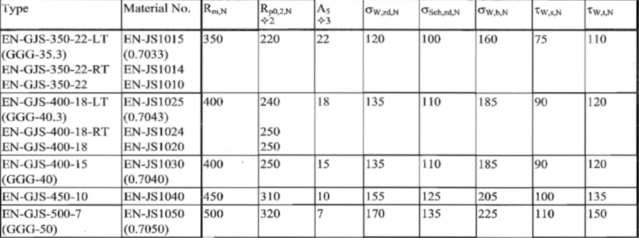
Gearbox elastomeric bearing calculation
Material using for Pin : EN-GJS-400-18-LT
Source: FKM Guidelines
16-12-2025
Md Razaul Karim Rahat
Gearbox, Brake, Coupling

Slide 8

Gears geometry calculation
Parameter | Formula | 1st stage | 2nd stage | 3rd stage
Input torque |  | 5,095 | 23.8 | NA
Output torque |  | 23.8 | 41.9 | NA
Pitch diameter,d (mm) | m*zp m*zs m*zr | ds-592, dp-624 , dr-1840 | ds-490 , dp-525 , dr-1540 | 1200 and 336
Outer dia ,Do (mm) | D0=(z+2).m | Ds-642,dp-676,dr-1900 | Ds-540,dp-560,dr-1600 | NA
Addendum,a(mm) | a=m | 16 | 14 | 2
Dedendum,b(mm) | b=1.25*m | 20 | 17.5 | 11.25
Face width,(mm) | 10 * module | 160 | 140 | 120
16-12-2025
Md Razaul Karim Rahat
Gearbox, Brake, Coupling

Slide 9
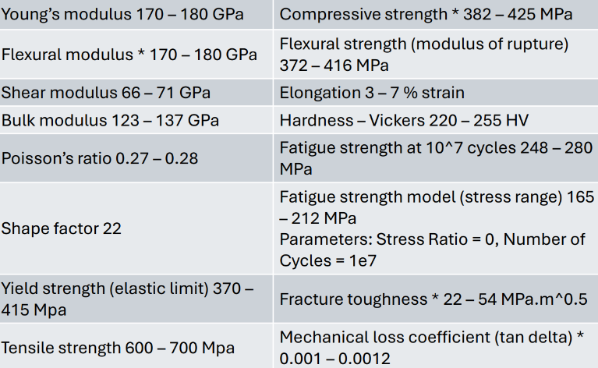

Cast iron,Mechanical Properties
16-12-2025
Md Razaul Karim Rahat
Gearbox, Brake, Coupling

Slide 10



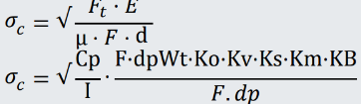


Force analysis, Stress, and Safety Factors (Zr-Ring gear)
Parameter | Formula | 1st stage | 2nd stage
Input torque,M (MNm) | Mi-5,095 M2=M1/i1 | 5,095 | 1.01
Tangencial force,Ft (MN) |  | 3.481 | 0.788
Radial force Fr (MN) |  | 1.567 | 0.587
Bending stress (m (MPa) |  | 137.89 | 92.67
Contact stress C,(MPa) |  | 216.57 | 170.34
Factor of safety (Bending) |  | 2.45 | 3.2
Factor of safety (Contact) |  | 1.38 | 2.11
16-12-2025
Md Razaul Karim Rahat
Gearbox, Brake, Coupling

Slide 11
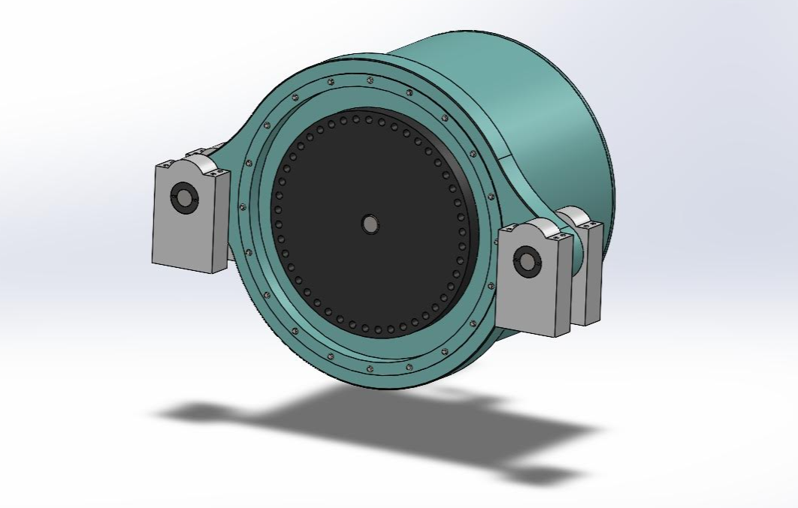
3D model Gearbox
Parameter
Ratio | 120
Stages | 3
Length | 1522 mm
Width | 3200 mm
Pin to pin distance | 2700 mm
Reference: Own design
16-12-2025
Md Razaul Karim Rahat
Gearbox, Brake, Coupling

Slide 12
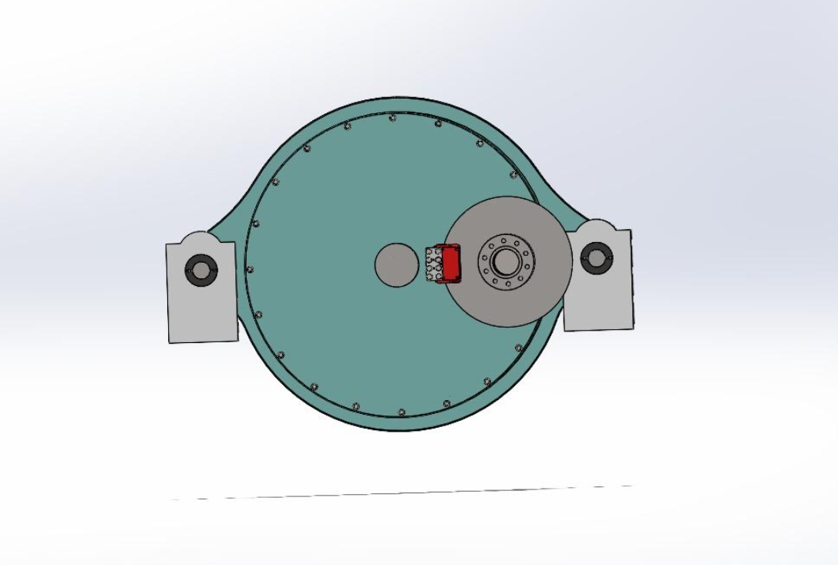
3D model Gearbox
Reference: Own design
16-12-2025
Md Razaul Karim Rahat
Gearbox, Brake, Coupling

Slide 13
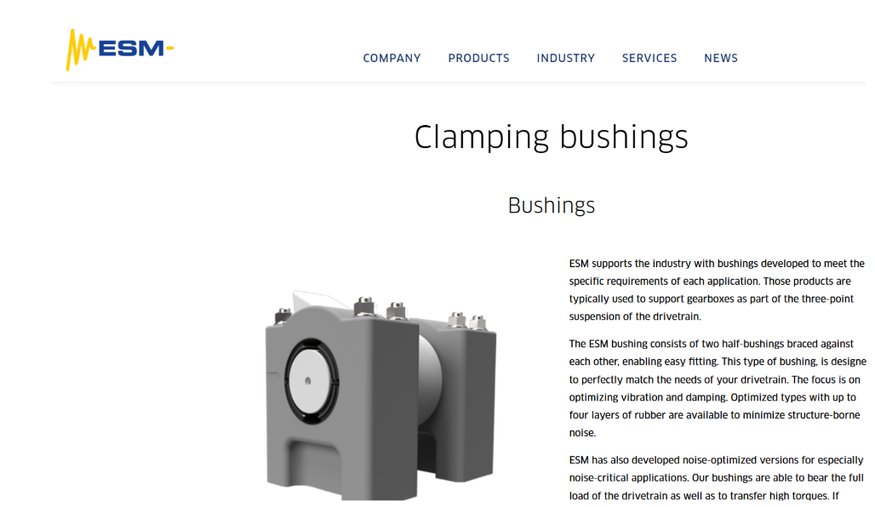
Gearbox elastomeric bearing
Source: ESM
16-12-2025
Md Razaul Karim Rahat
Gearbox, Brake, Coupling

Slide 14
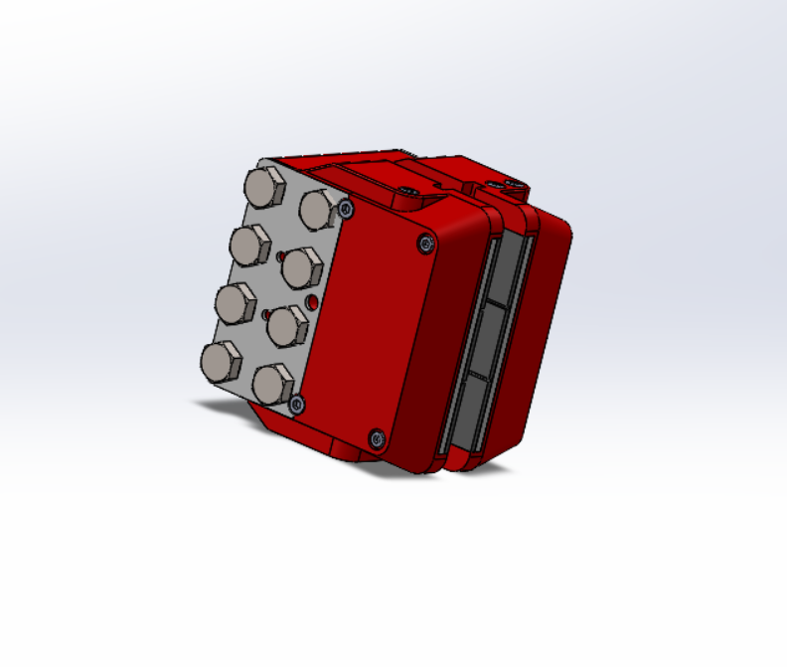
3D model Brake
Parameter
Type | Svendborg 300 dual action
Length | 220 mm
Width | 167 mm
Weight | 62 Kg
Reference: Own design
16-12-2025
Md Razaul Karim Rahat
Gearbox, Brake, Coupling

Slide 15
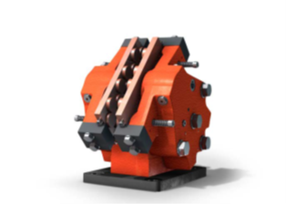
Selection of the brake caliper
To bring a drivetrain that is operating at a reduced/idling speed to a complete stop and provides holding functionality.
Why svendborg..?
Developed a series of hydraulically-applied caliper brakes.
Provide easy maintenance and friction pad replacement.
Also feature corrosion protection, monitoring systems (on-off switch, pad wear monitor, etc.).
high thermal dissipation during dynamic braking
BSAK 300 Dual-Action
Hydraulic pressure applied and spring return.
Clamping force: 0 to 55.000 N
Nominal braking force: 0 to 44.800 N
Reference: Svendborg
16-12-2025
Md Razaul Karim Rahat
Gearbox, Brake, Coupling

Slide 16
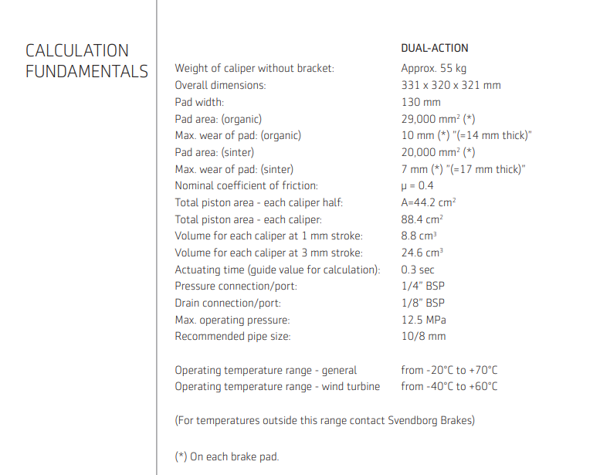
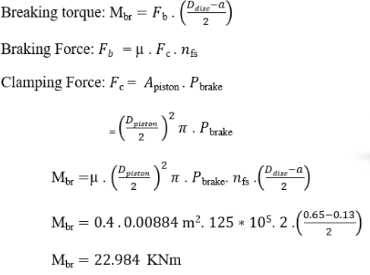
Brake calculation
16-12-2025
Md Razaul Karim Rahat
Gearbox, Brake, Coupling

Slide 17
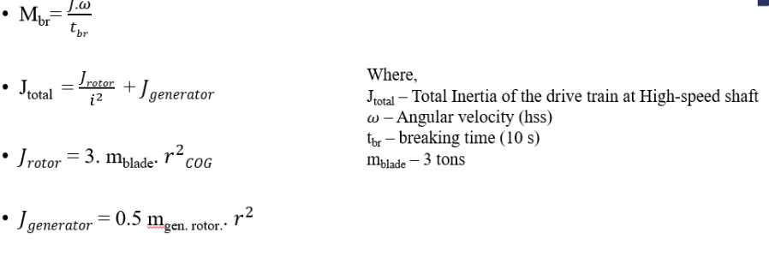
Brake calculation
16-12-2025
Md Razaul Karim Rahat
Gearbox, Brake, Coupling

Slide 18
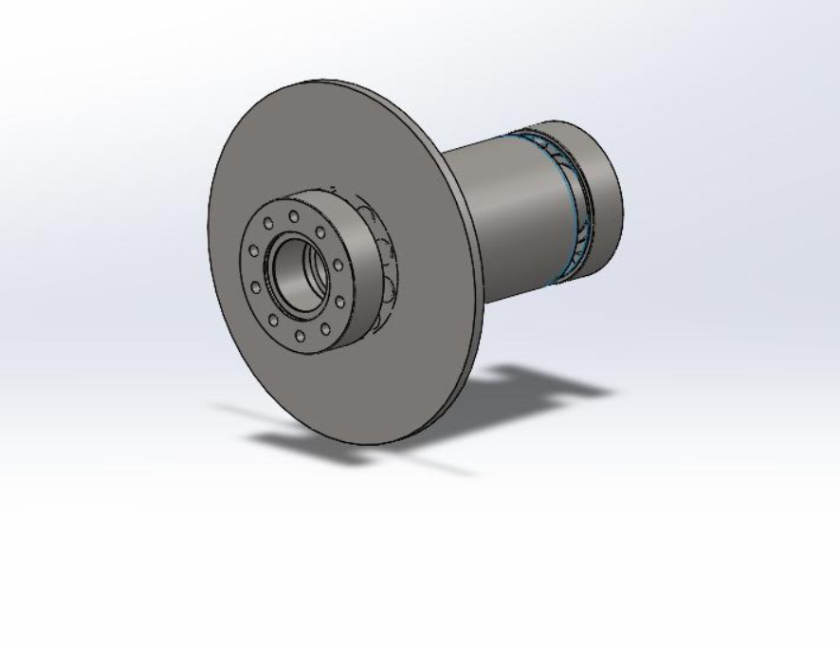
3D model Coupling
Parameter
Model | KTR RADEX NANA
Length | 945 mm
Disc Radius | 450 mm
Weight | 170 Kg
Reference: Own design
16-12-2025
Md Razaul Karim Rahat
Gearbox, Brake, Coupling

Slide 19
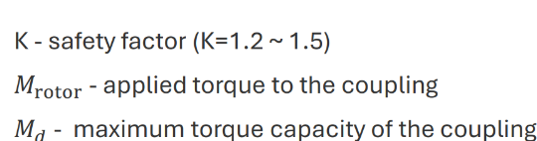
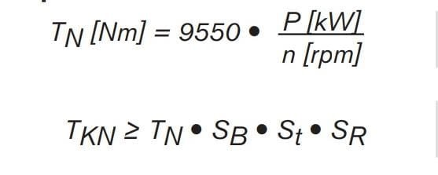
Coupling Torque calculation
Coupling
Calculate the compensating torque applied to the coupling
Md=Md rotor * K = 5,095* 1.5 =7.6425 MNm
Nominal Torque = 3,979.16 Nm
T_{kN} = 5,769.791667 Nm, On Considering Size Factor as 1.45
According to the Calculated Torque , The size of the High-speed shaft side could be chosen as 115mm With 6 Holes
16-12-2025
Md Razaul Karim Rahat
Gearbox, Brake, Coupling

Slide 20
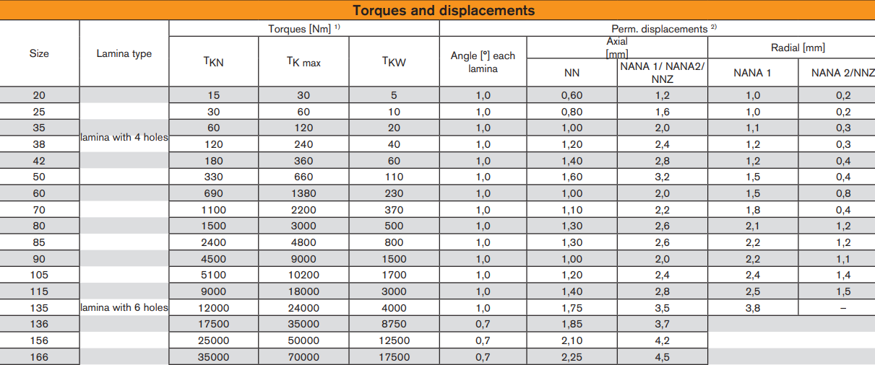
Coupling size overview
Source-KTR
16-12-2025
Md Razaul Karim Rahat
Gearbox, Brake, Coupling

Slide 21
Weight and Cost estimation
No | Components | Weight estimation | Cost estimation
1 | Gearbox | 11700 Kg | 53000 €
2 | Elastomeric bearing | 58 Kg | 261 €
3 | Brake caliper | 62 Kg | 279 €
4 | Coupling | 170 Kg | 765 €
Total Weight | 11,990 Kg
Total cost | 55000-65000 €
Source-https://www.indexbox.io/search/cast-iron-price-per-kg
16-12-2025
Md Razaul Karim Rahat
Gearbox, Brake, Coupling

Slide 22
Bibliography
Gearbox
Previous year Optimus projects(60E,92LE,Shakti 14-12-2025
Roloff Matek Maschinenelemente 14-12-2025
Lecture notes – Mechanical drive train by Prof.Peter Quell.13-12-2025
Shigley's mechanical engineering design and PSG data book 12-12-2025
DNV and IEC-61400-4 guidelines 13-12-2025
Brake
Svendborg handbook 14-12-2025
Previous year Optimus projects(60E,92LE,Shakti 13-12-2025
Coupling
KTR handbook 15-12-2025
Previous year Optimus projects(60E,92LE,Shakti 14-12-2025
16-12-2025
Md Razaul Karim Rahat
Gearbox, Brake, Coupling

